Slide 1
CSE 426
COMPILER LAB
Submission Date : 19/10/2025
Submitted To:
Md.Shafayatul Haque
Lecturer
Department Of CSE,UAP
Submitted By:
Labnaya Saha
Reg No:21201059
Sec:B2

Slide 2
Objective: To design and implement a mini compiler that performs Lexical Analysis, Symbol Table, Syntax Error Analysis,Parser/Abstract Syntax Tree, Intermediate Code Generation,Code Optimization,Assembly Code using Flex, Bison, and Python.
Github Link: https://github.com/Labanya23/CSE-430-Compiler-Lab/tree/3c6a2f84a4662b73ba75c332ca661b0bcd705268/Mini%20Compiler%20Project_21201059
Key Responsibilities:
Folder Nmae: Mini Compiler Project 21201059
Folder 1 – Lexical Analysis → Used Flex and C to detect keywords, identifiers, digits, and comments. → Tested with multiple input files (.txt / .cpp/ .c).
→Command: cd “Lexical”
flex token.l
gcc lex.yy.c – o a.out
./a.out < input0.txt

Slide 3
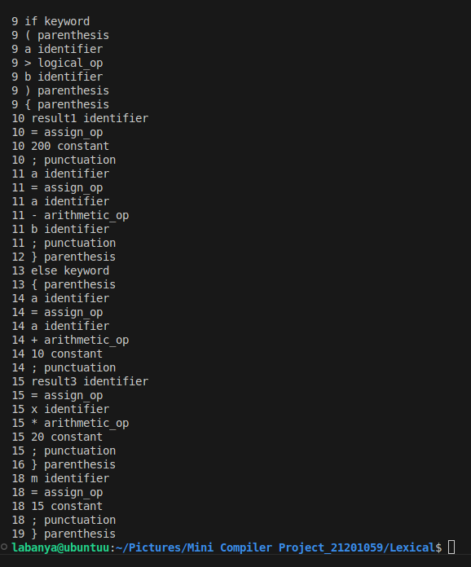
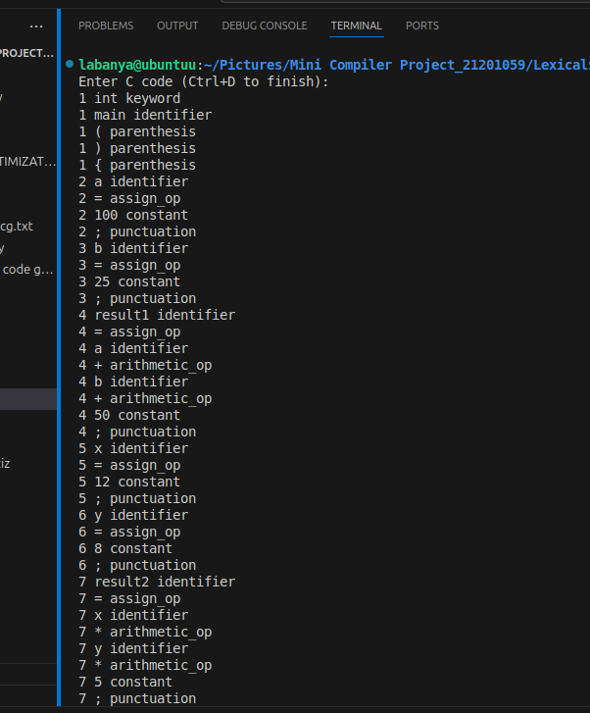
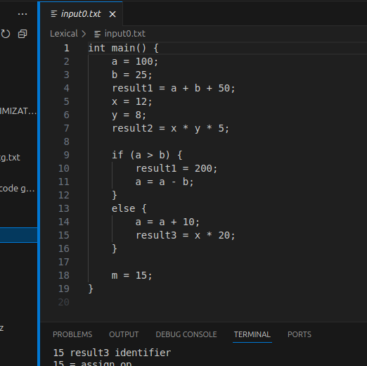
Sample Input:
Output:

Slide 4
Folder 2 – Symbol Table → Used Flex and C
→ Implemented symbol table using struct and array in C. → Stored name, type, size, and address for each variable.
→ Tested with multiple input files (.txt / .cpp/ .c).
→Command: cd “../symboltable”
flex symbol.l
gcc lex.yy.c – o a.out
./a.out input0.cpp

Slide 5
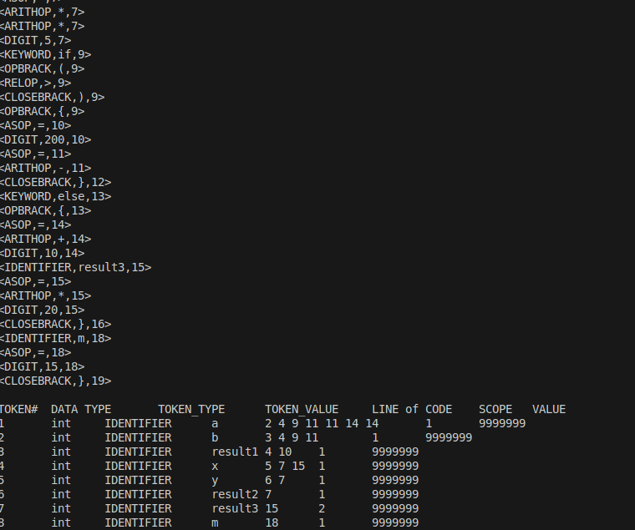
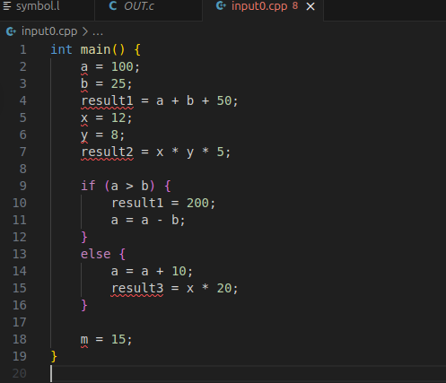
Sample Input:

Slide 6
Folder 3 – Syntax Analysis → Used Flex, Bison, GCC to check grammar and report syntax errors.
→ Tested with multiple input files (.txt / .cpp/ .c).
→Command: cd “../syntax analyziz”
bison –d lexical.y
flex lexical.l
gcc lex.yy.c lexical.tab.c – o a.out
./a.out < input1.txt

Slide 7
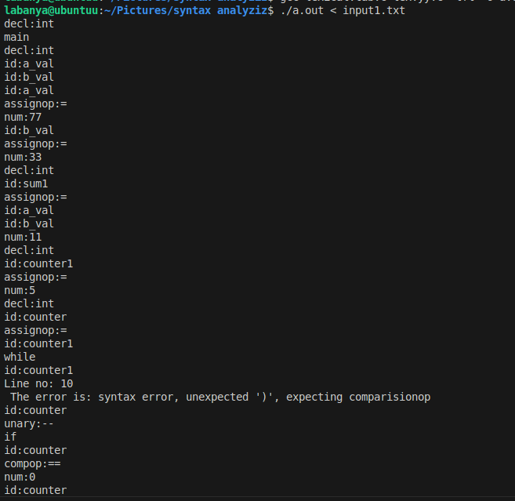
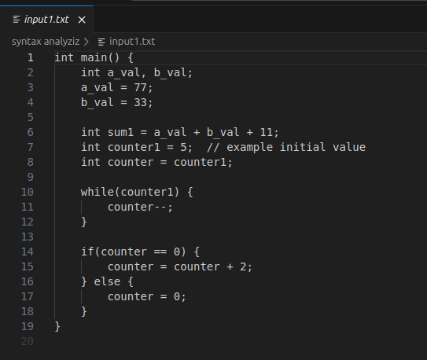
Output:
Input Sample:

Slide 8
Folder 4 – Abstract Syntax Tree
→ Generated AST using binary tree structure. → Linked operators and operands as tree nodes.
→ Used Flex, Bison, GCC to check grammar and report syntax errors.
→ Tested with multiple input files (.txt / .cpp/ .c).
→Command: cd “../parser tree”
bison –d tree.y
flex tree.l
gcc lex.yy.c lexical.tab.c – o treee
./treee < input.cpp

Slide 9
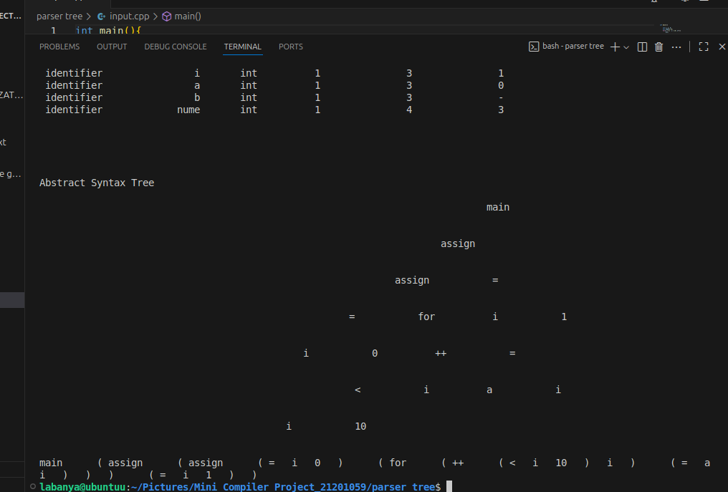
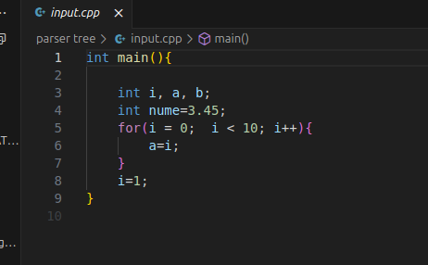
Output:
Sample Input:

Slide 10
Folder 5 – Intermediate Code Generation → Created three-address code (TAC) for each statement. → Saved output in text files for next phase.
→ Used Flex, Bison, GCC to check grammar and report syntax errors.
→ Tested with multiple input files (.txt / .cpp/ .c).
→Command: cd “../intermediate code generator”
bison –d icg.y
flex icg.l
gcc lex.yy.c icg.tab.c – o a.out
./a.out < input.cpp

Slide 11
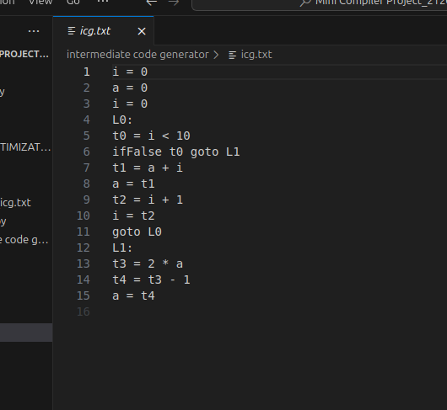
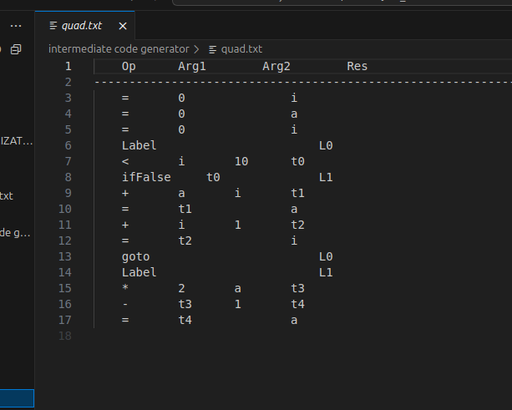
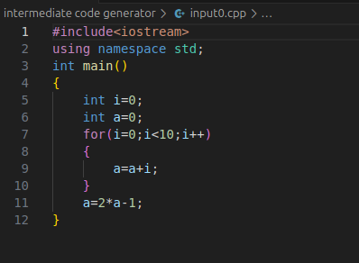
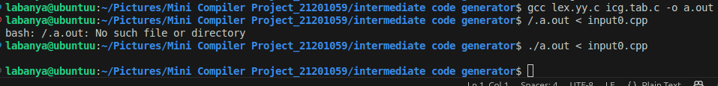
Output Of Tac
Quadruple format
Input File:
Terminal:

Slide 12
Folder 6 – Code Optimization (Python+Constant Propagation,Constant folding and Dead Code Elimination): → Used Python script to remove redundant instructions. → Optimized ICG for multiple input files using list-based processing.
→ Tested with multiple input files ((.txt / .cpp/ .c).
→Command: cd “../IC_CODE OPTIMIZATION”
python3 optimizer.py input.txt --print

Slide 13
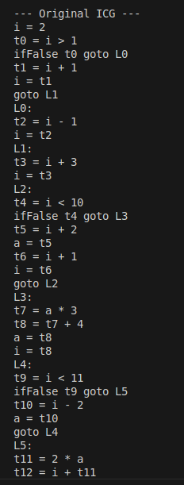
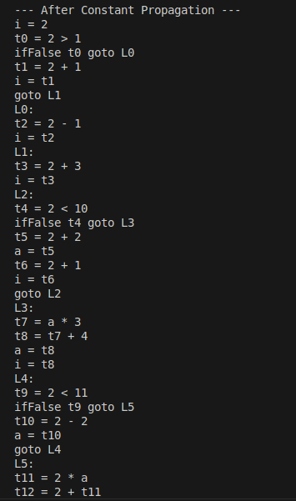
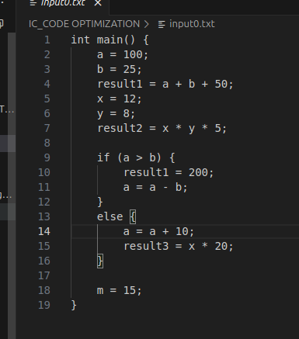
Input Before Optimization:
Output After Optimization:

Slide 14
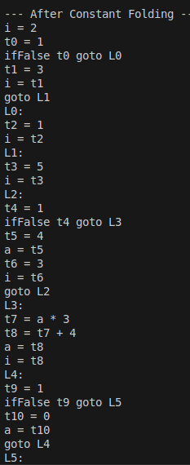
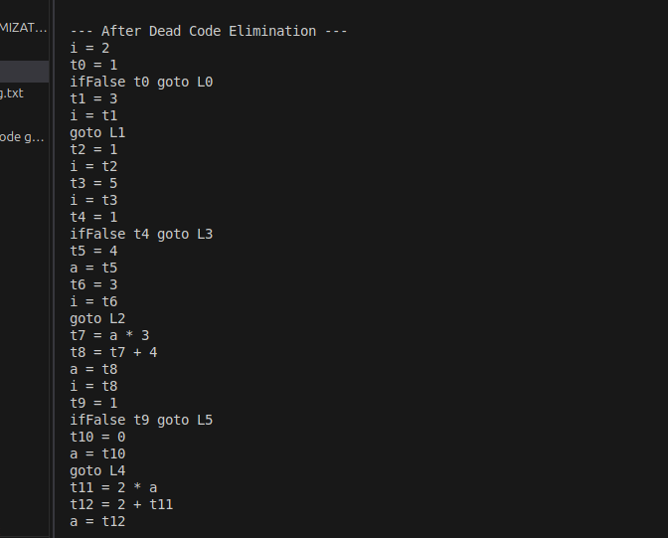

Slide 15
Folder 7 – Assembly Code Generation (Python) → Converted optimized code into assembly format (.s file). → Used hash map to track variables and improve memory usage.
→ Tested with multiple input files ((.txt / .cpp/ .c).
→Command: cd “../ Assembly”
python3 assembly.py icg.txt
python3 assembly.py input.txt

Slide 16
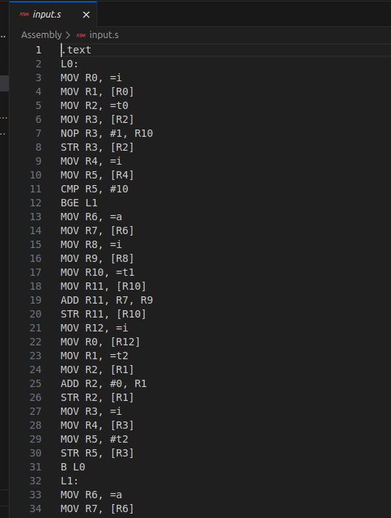
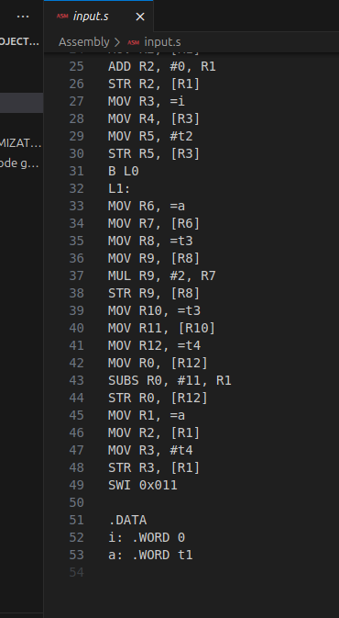
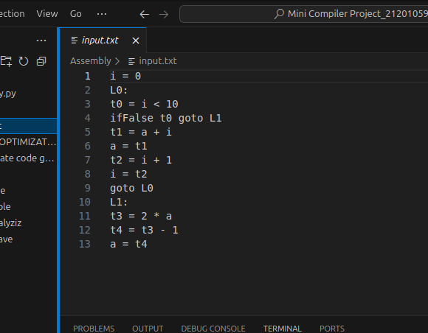
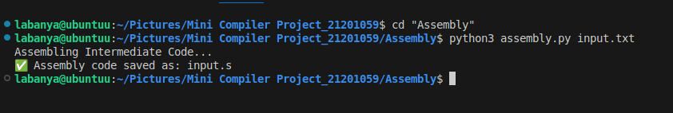
Input:
Output:

Slide 17
Conclusion
Through this project, I successfully implemented a simplified compiler that performs all major phases — from lexical analysis to assembly code generation. Each stage was tested using multiple input files to ensure correctness. The project enhanced my understanding of compiler design concepts, syntax parsing, and code optimization. It also gave me practical experience using Flex,Bison, C,C++ and Python, and helped me understand how source code is translated step by step into machine-level instructions.

Slide 18
THANK TOU

